Slide 1

STORE MANAGEMENT SYSTEM
DELTA
Consultancy Services

Slide 2



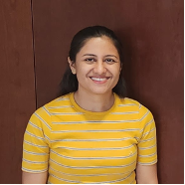


GROUP - D
Sree Harika Datla
Atish Kumar Dash
Bhumika Deo
Silky Batra
Anubhav Agarwal

Slide 3
GROUP - D
Anubhav Agarwal
Silky Batra
Bhumika Deo
Atish Kumar Dash
Sree Harika Datla

Slide 4
Measurable Organization Value
Area of impact | Value | Metrics | Time Frame
Financial | Increase earnings, reduce expenses, improve profitability, control cash flow, implement financial controls | 10% earnings increase within 1 year, 15% decrease in expenses within 6 months, 20% profitability improvement within 2 years, 25% reduction in outstanding receivables within 1 year, 100% compliance with financial controls within 3 months | Within 1 year for earnings, expenses, and cash flow; within 2 years for profitability; within 3 months for financial controls
Operational | Streamline processes, increase efficiency, enhance quality | 30% reduction in process time within 1 year, 20% increase in productivity within 6 months, 15% reduction in defects within 1 year | Within 1 year for process streamlining and quality enhancement; within 6 months for efficiency improvement
Strategic | Achieve financial ease-of-use, meet milestones, align with organizational goals | 30% increase in customer satisfaction within 1-year, successful completion of milestones, support 90% of organizational goals within 1 year | Within 1 year
Metrics for Evaluation
Financial Impact
Operational Impact
Strategic Impact

Slide 5
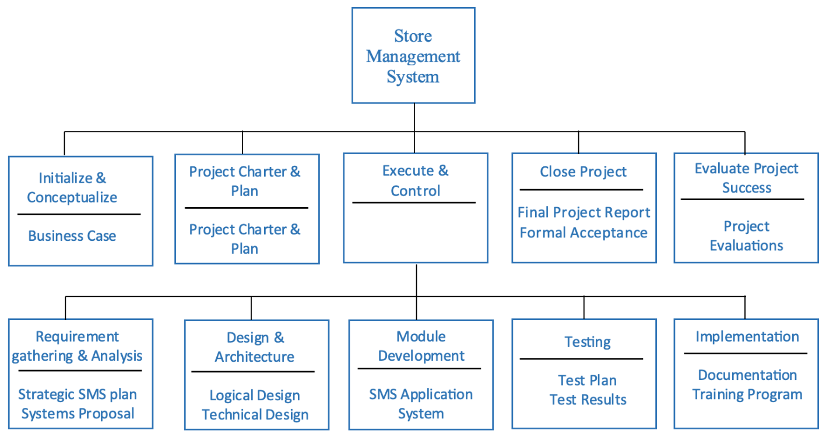
Scope & Deliverables
Deliverable Structure Chart

Slide 6
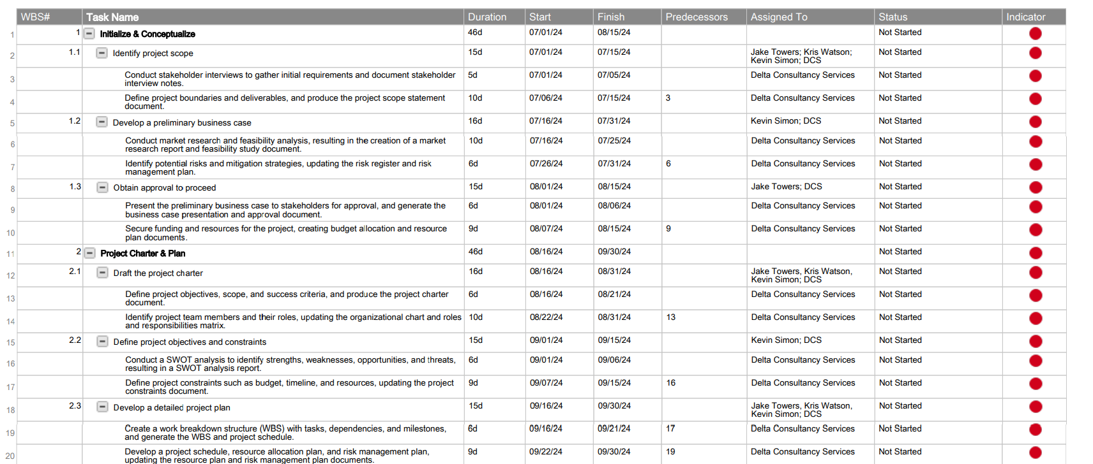
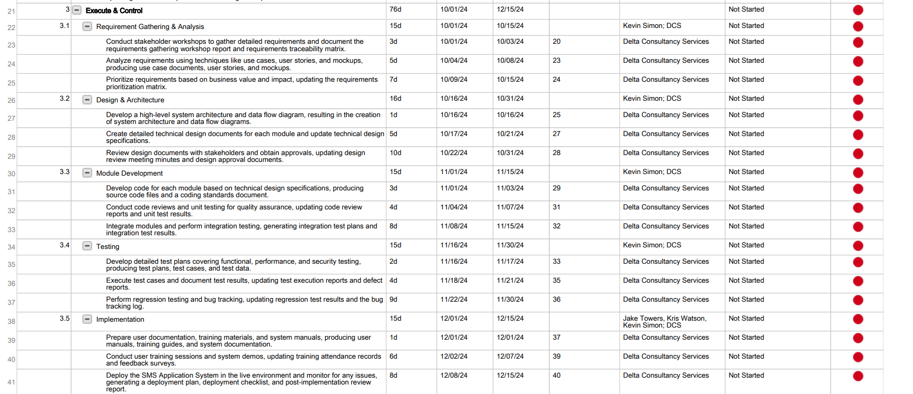
Schedule Overview
Project Schedule
Start Date: July 1, 2024
End Date: Jan 5, 2025
Total Days: 238 Days

Slide 7
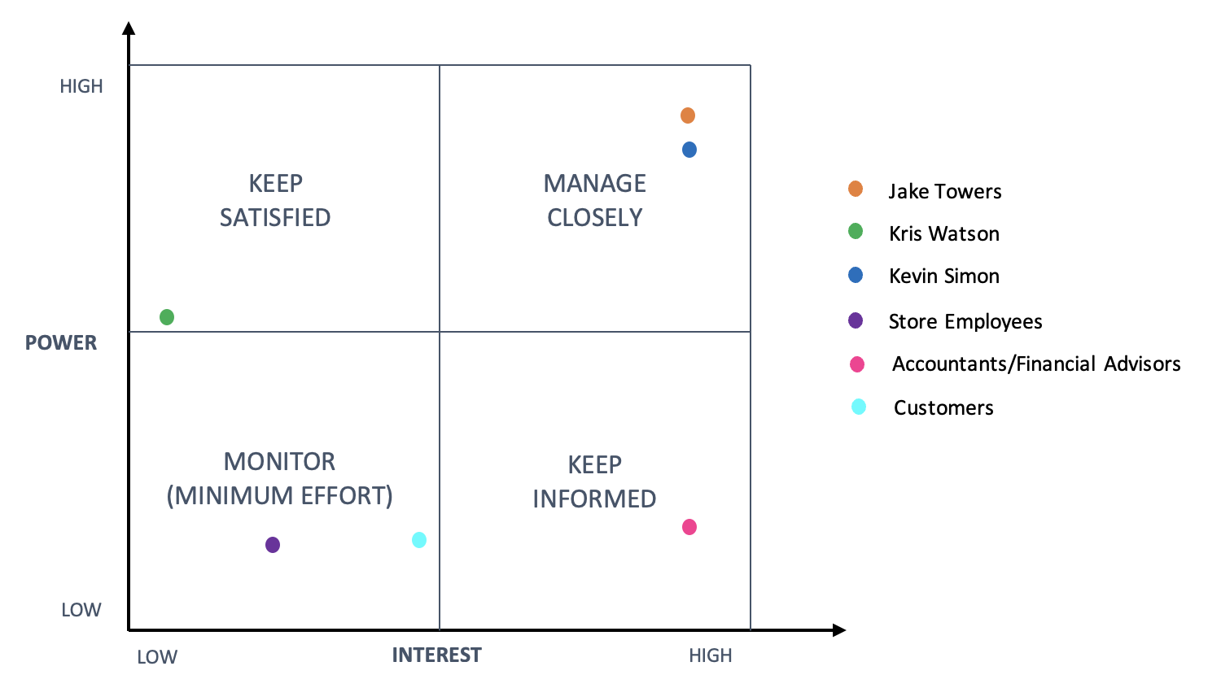
Stakeholder Management
Stakeholder Analysis – Interest- Power Matrix
We utilized an interest-power matrix to assess the required level of involvement, considering each stakeholder group's interest and impact on the project. This enabled us to:
Manage Risk Effectively
Strategic Engagement
Ensure the project’s alignment with strategic goals
Allocate Resources Efficiently
Decision Making

Slide 8
Stakeholder Management
Stakeholder Analysis – Engagement Assessment Matrix
Stakeholder | Unaware | Resistant | Neutral | Supportive | Leading
Jake Towers |  |  | C | D
Kris Watson |  | C |  | D
Kevin Simon |  |  |  |  | C D
Store Employees | C |  |  | D
Accountants / Financial Advisors |  |  | C | D
Customers | C |  |  | D
We used a stakeholder engagement assessment matrix to determine different groups of stakeholders and their respective levels of support for the project. This enabled us to:
Prioritize Resources
Enhanced Stakeholder Buy-In
Tailor communication Strategies
Mitigate Risk and Resistance
Optimize Resource Allocation

Slide 9
Communication Matrix
Communication Matrix
Stakeholder | Learn from Stakeholder | Share with Stakeholder | Timing | Effective Method | Owner
Jake Towers | Understand vision, goals, concerns, and priorities | Provide regular project updates | Initial meeting within two weeks, Monthly progress updates, Final review one week before completion | In-person meetings, Email, Phone calls | Project manager
Kris Watson | Learn vision, criteria, and perspective | Share updates on initiatives, class offerings, and product insights | Weekly updates before decisions | In-person meetings, Phone calls | Project manager
Kevin Simon | Understand efficiency perspective, inventory concerns, and implementation vision | Share progress, challenges, and incorporate inputs | Weekly updates during milestones | In-person meetings, Video conferences | Project manager
Store Employees | Identify and solve obstacles | Ensure understanding and prompt communication | Weekly updates as needed | In-person meetings | Project Manager
Accountant/Financial Advisors | Understand financial systems and impacts | Share progress, system demos, involve in planning | Monthly meetings or check-ins | In-person meetings, Video conferences, Email | Jake Towers
The approach for developing the communication matrix involved stakeholder analysis, requirement gathering, collaborative planning, matrix design, feedback iteration, and implementation with ongoing monitoring for optimization. This enabled us to:
Adapt communication methods based on stakeholder preferences.
Effectively document accountability and maintain transparency.
Implement regular feedback mechanisms for stakeholder input and issue resolution.

Slide 10
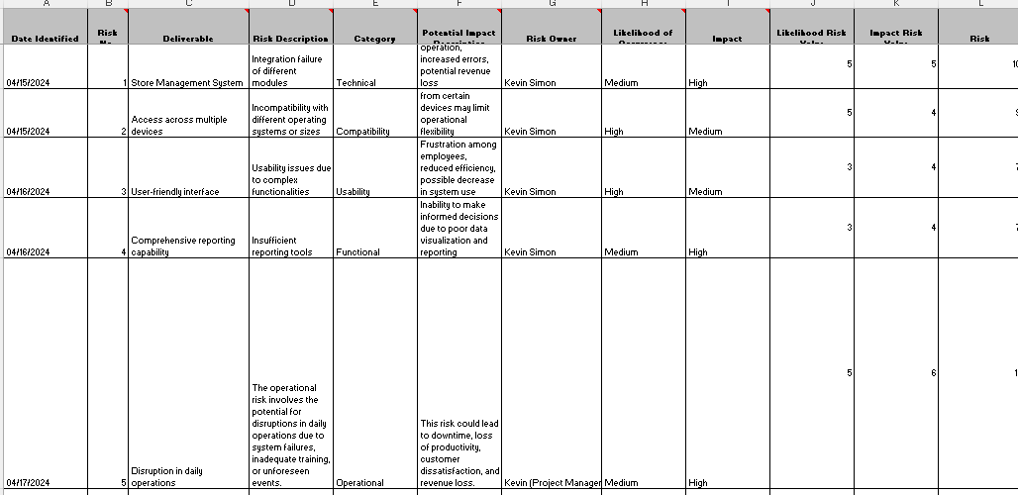
Risk Register
Risk Register
Creating a risk register for Project Idea 2, which involves implementing a comprehensive store management system for Elite Art Products, is crucial for identifying and mitigating potential risks. Spearheaded by Kevin, the business manager, the initiative aims to streamline operations and enhance financial oversight for the company.
Major risks include regulatory compliance, technical challenges, user training, etc.
Identifying and addressing at least five key risks
Safeguarding project success, aligning with company's long-term goals

Slide 11
Quality Management Plan
Major Activities Undertaken:
Regular reviews and testing to identify and address quality issues.
Use of metrics to monitor project progress and product quality.
Continuous improvement based on feedback and lessons learned.
Responsibilities:
Project manager oversees plan implementation.
Development and testing teams execute quality assurance activities.
Stakeholders provide feedback and participate in testing.
Documentation:
Maintain records of quality assurance activities and test results.
Generate regular quality reports to communicate project status.
Document lessons learned for future projects.
The Quality Management Plan ensures that the store management system meets the highest standards of quality to effectively support Elite Art Products' operations.
It is essential for Elite Art Products because
It ensures that their store management system meets the highest standards of functionality, reliability, and user satisfaction
By establishing clear objectives, activities, and control measures, the plan ensures that the system aligns with user requirements and operates effectively
It also facilitates proactive identification and resolution of quality issues

Slide 12
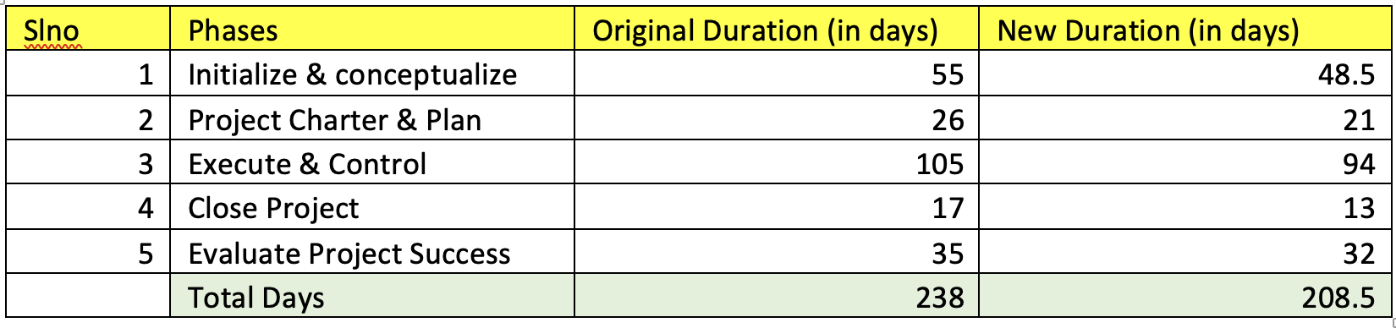
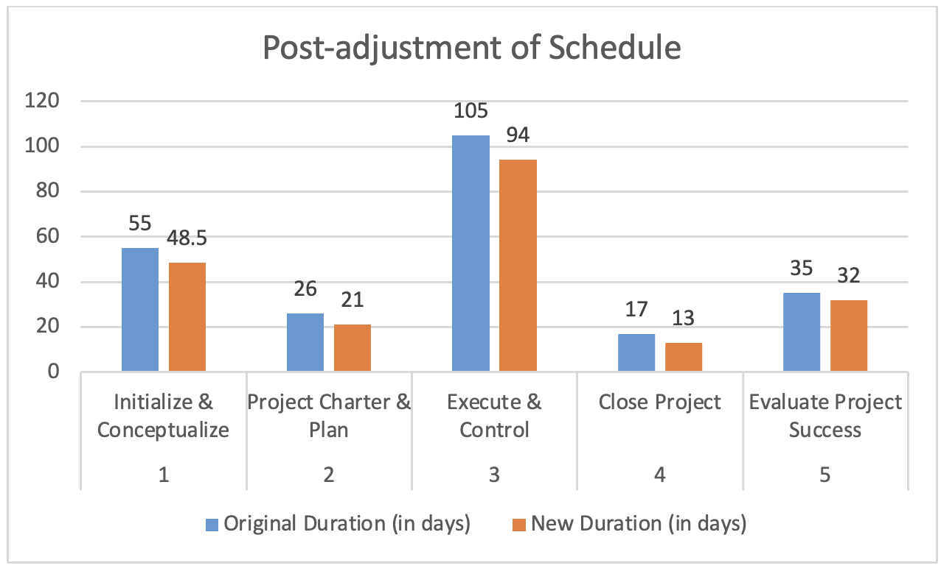
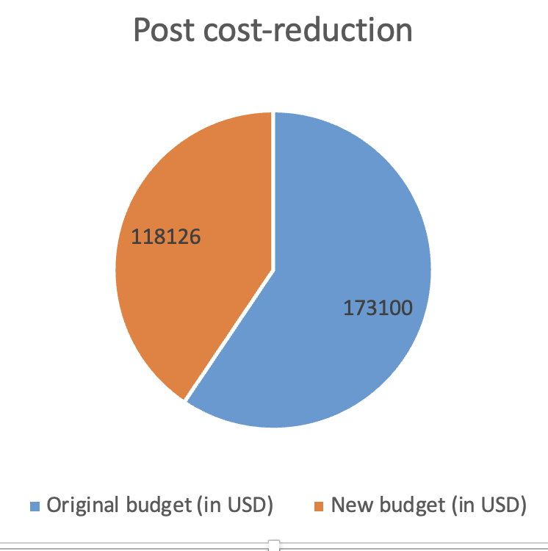
Organizational Change Management Plan
Project Summary Report
We have successfully implemented project management techniques to enhance our efficiency and productivity.
Automation Tools: Implemented automation tools to streamline tasks, reduce costs, and enhance consistency, allowing focus on higher-value activities.
Scope Streamlining: Prioritized clear definition of project boundaries and alignment of deliverables with objectives to prevent scope creep, ensuring adherence to timelines and budgets.
Fast Tracking Techniques: Employed fast tracking methods to expedite project schedules by overlapping activities and identifying critical paths, maintaining quality while accelerating completion.

Slide 13

Thank You

